Slide 1

Creating a Public Service Announcement

Slide 2


What is a PSA?
Public Service Announcement

Slide 3

PSA
Brief community message that promotes the community interest in a specific cause
A PSA is commonly shown on television or before movies or as a radio spot
PSAs often advertise the benefit the group provides to the community
PSAs sometimes use donated time from the station airing
Photo by Andres Siimon on Unsplash

Slide 4

Building a PSA
A PSA takes research, drafting, and production to make it on the big screen
The first step is researching, which gives you background on the subject and helps you determine who your target audience will be.
With research complete, drafting out your idea is next. This involves writing a script and creating a storyboard, which is a sketch of what you want the PSA to look like scene by scene.
After drafting, the actual production of the PSA begins. This includes finding actors and filming the PSA.
Photo by Jesus Loves Austin on Unsplash

Slide 5
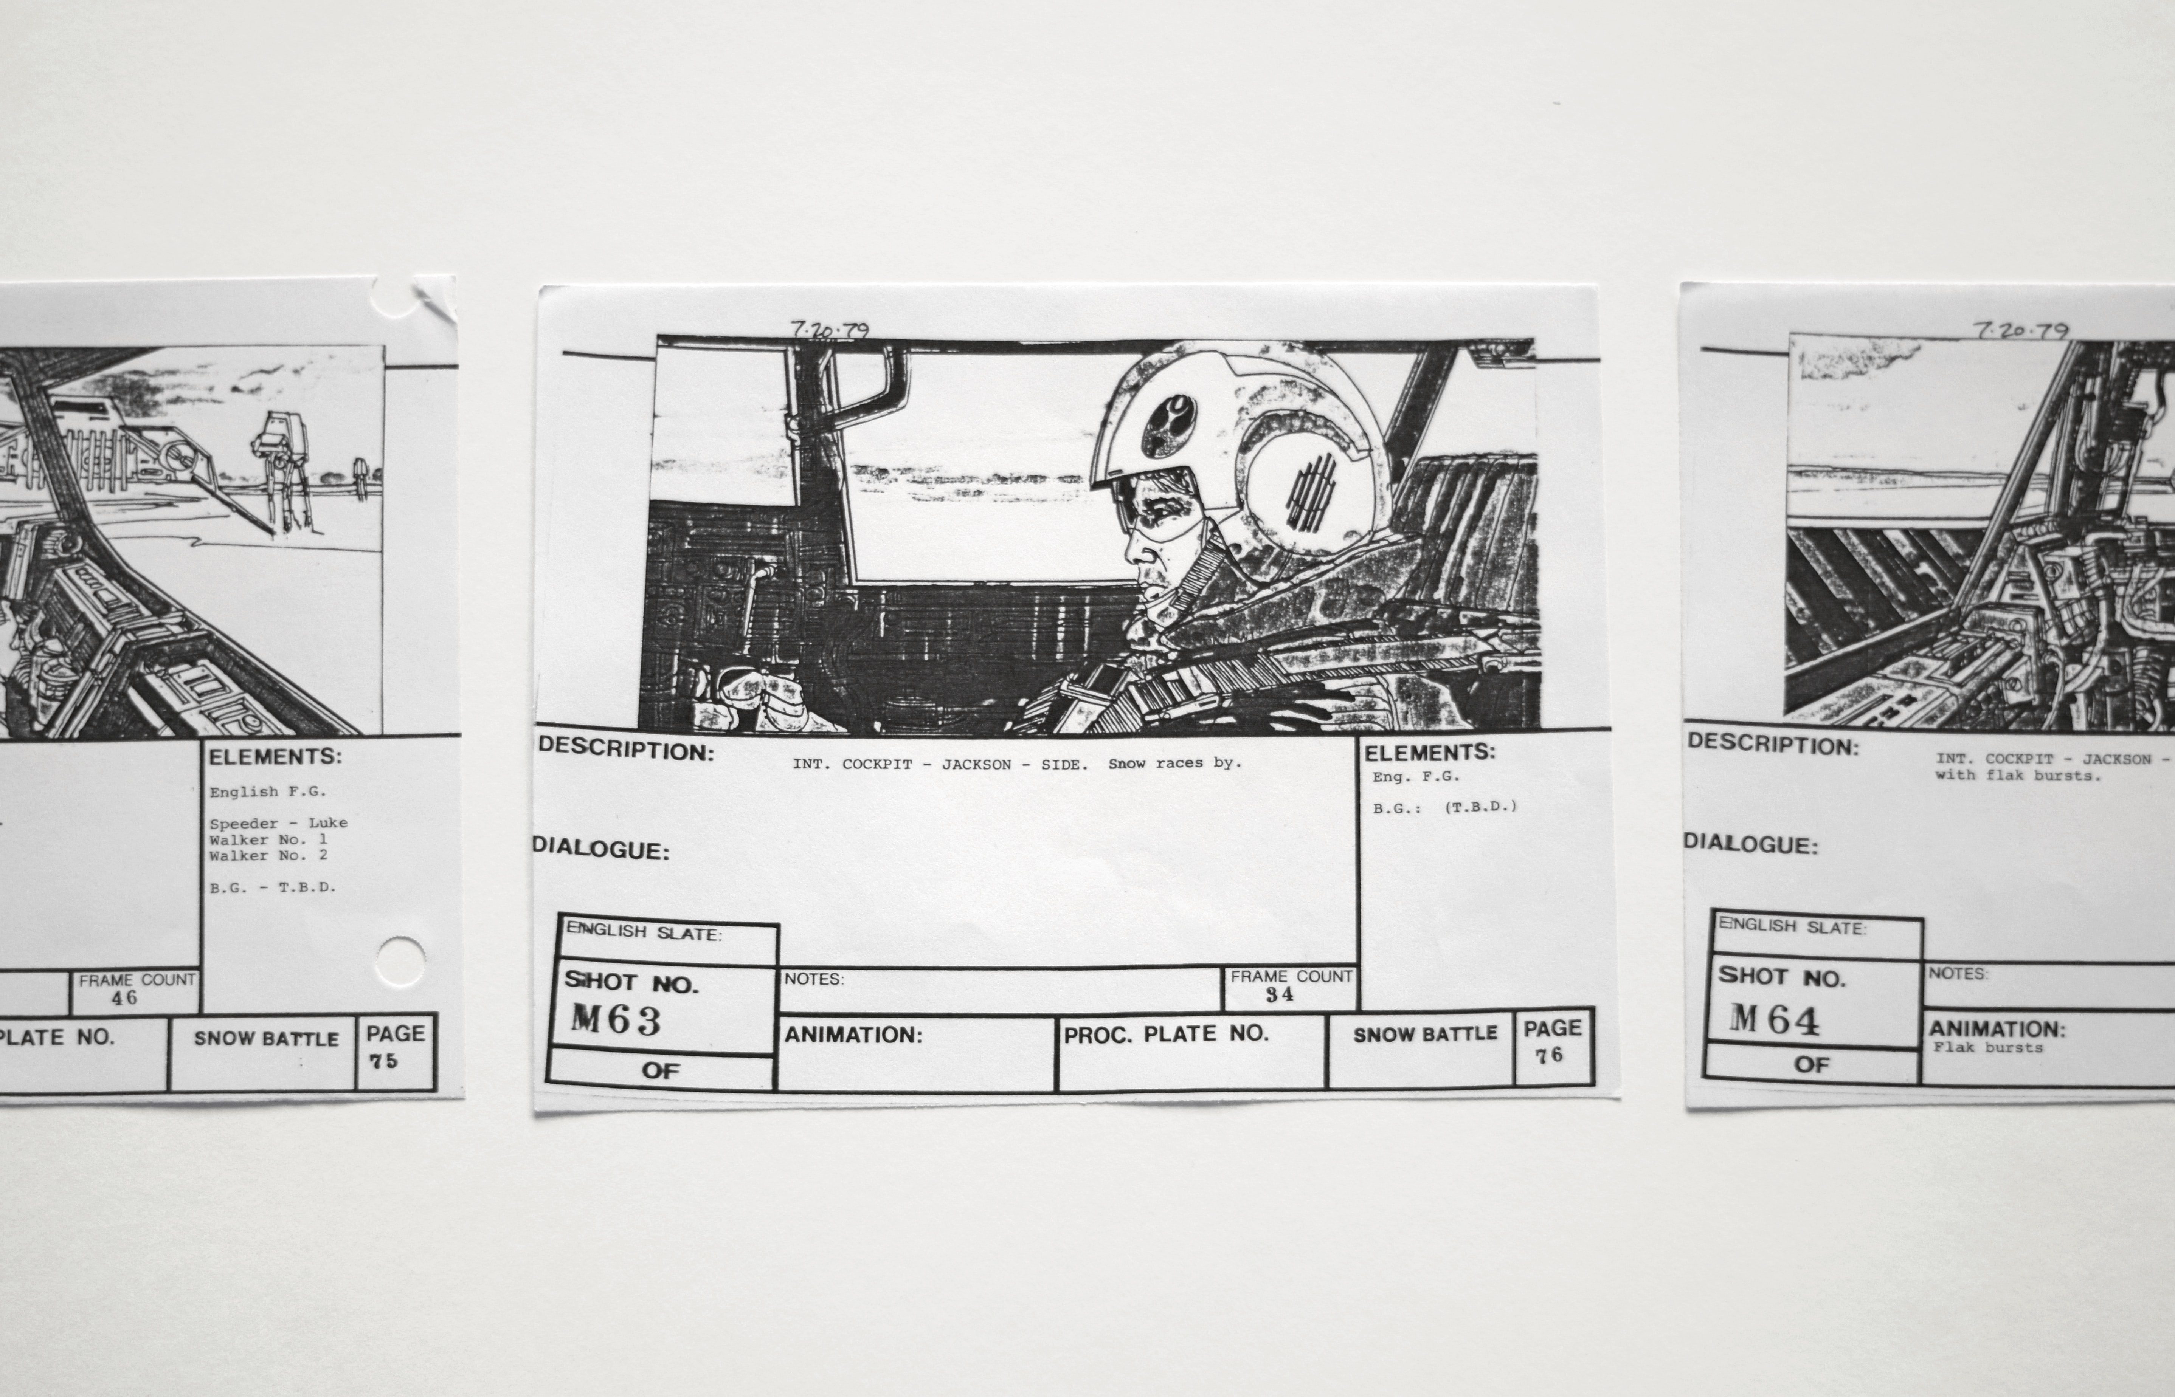
Storyboarding
A storyboard is a visual representation of what you want to happen in each scene in the PSA
A PSA is usually hand drawn in panels that includes the action and scripting of the scene
Storyboards are rough drafts, not usually full of detail
Photo by Matt Popovich on Unsplash

Slide 6




Assignment
Create a PSA storyboard the promotes safe driving for teenagers
Topic
Set a topic, such as not drinking and driving or not being a distracted driver
Target Audience
Determine who your target audience is and make sure it is age and subject appropriate
Sketch
Draw out the scenes in the provided panels. Remember this is just a sketch – stick figures are fine
Submit
Turn your sketch in for a chance to be featured on the ACT Missouri website

